Slide 1

Work Related learning
LO 4-Week 10-
Examine the relationship between the organisation and its stakeholders

Slide 2
Learning outcomes
At the end of this class , students will be able ;
1- Outline the roles of stakeholders in Health and Social Care
2 - Exploring the roles of stakeholders in NHS

Slide 3

LO1- Activity -10 mins
Conduct internet Research ;
What are the roles of stakeholders in NHS?.
Feedback to the class.

Slide 4
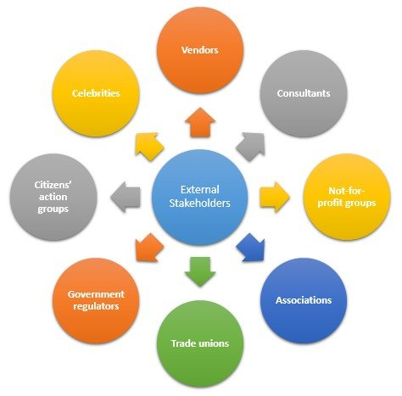

Slide 5

In England, the organisations making up the NHS include:
Primary care organisations – Independent businesses offering NHS services, including GP practices, dental practices, opticians
Acute (hospital) trusts – Providers of hospital-based NHS services
Mental health trusts – Organisations which offer mental health and social care services, e.g. Mind.org.uk
Community trusts – Providers of community-based services, such as district nursing, physiotherapy and speech and language therapy
Ambulance trusts – Organisations which offer NHS transportation services emergency and non-emergency care
Charities and social enterprises – organisations which provide support services to the NHS.

Slide 6
All assignment will be submitted in electronic format and uploaded to LSC Portal on Turnitin
Date assignment set | April 2021
Submission deadline date | 12th July 2021
Return date to students | 9th August 2021

Slide 7

Presenting your assignment
Title page-Your student number, the module and submission date
Content page
Introduction
Font –Ariel, Times New Roman
Font size -12
Line spacing – 1.5
Paragraphing-Not too short or too long
Page number
Make use of sub-headings for clarity
In text referencing using Harvard referencing style
Reference list using Harvard referencing style
Reference list should be in alphabetical order
Proof read for grammar errors
Submit as a single document i.e. a word document or Pdf
Conclusion

Slide 8
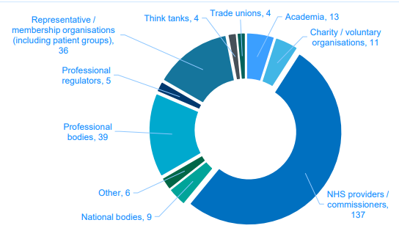

Slide 9
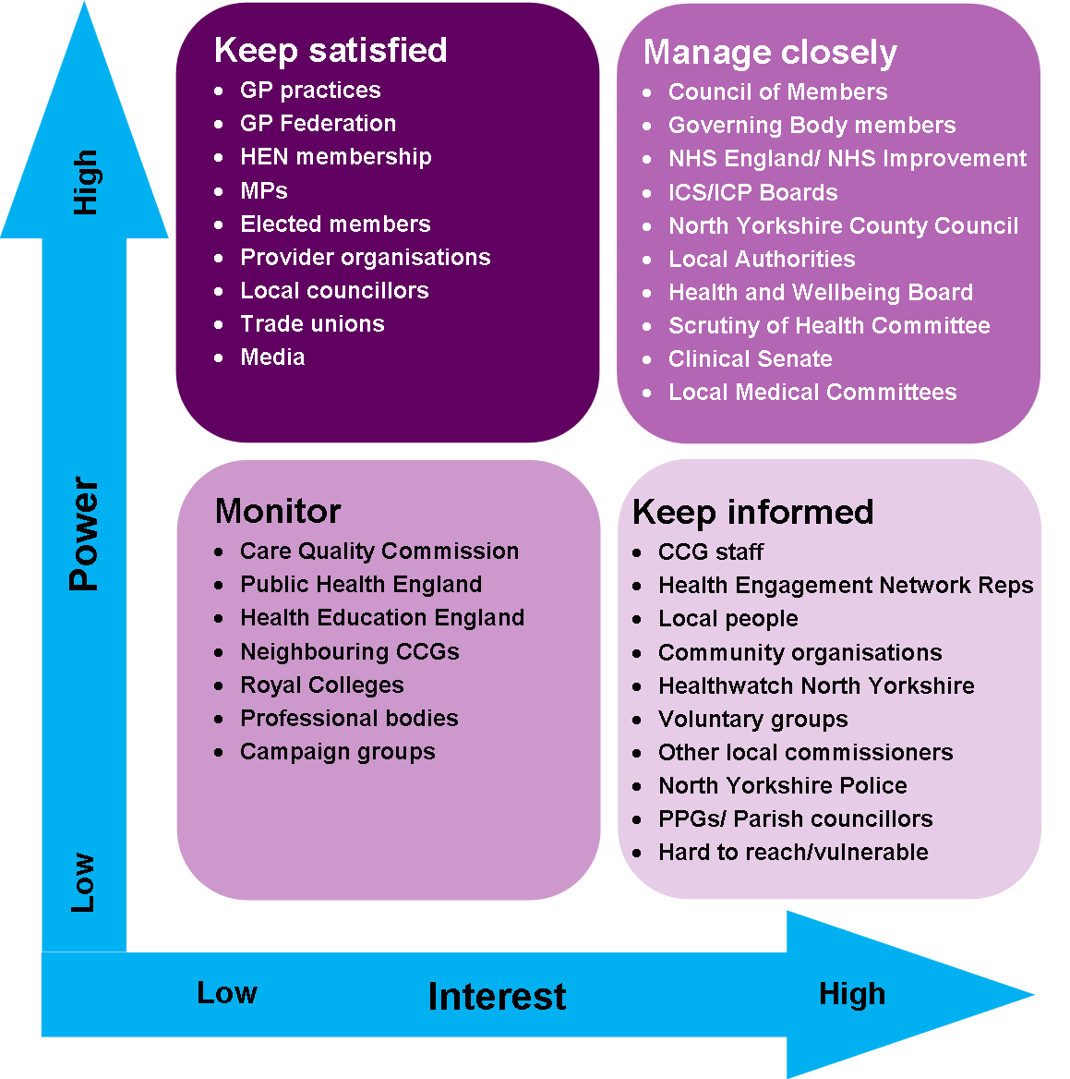
Roles of the NHS England as a Stakeholder

Slide 10
Stakeholders can be defined as any person or group of people who have a significant interest in services provided, or will be affected by, any planned changes in an organisation or local health community.
They can be internal or external to that local health community, and they can comprise staff, patients, trade unions, MPs and members of the public and community groups.

Slide 11

Role of NHS England
Keeping stakeholders informed and involved
NHS England works closely with stakeholders and staff to ensure they are involved in all stages of the development of PCS services.-Primary Care Support (PCS) Services
To ensure that NHS England and NHS Improvement, as the commissioner for primary care support services, understands the views of key stakeholders and enables them to influence the delivery and direction of the services, a stakeholder forum has been constituted.
Membership of the stakeholder forum includes:
British Medical Association (BMA)
Local Optical Committee Support Unit (LOCSU)
Optical Confederation, Pharmaceutical Services Negotiating Committee (PSNC)
British Dental Association (BDA)
Royal College of GPs (RCGP).

Slide 12

The Role of NHS staff as a stakeholder
Meeting service user needs
Recognising users of services as individuals
Recognising and actively promoting respect for diversity, difference and adopting inclusive practices
Taking a holistic approach to meeting needs and safeguarding/protection: physical, mental, social, emotional, cognitive, e.g. including communication
Providing individuals with the tools for self-determination
Enabling service users’ ownership of their own care journey
Integrating service user feedback and experience into quality improvement measures

Slide 13
Impact of NHS staff as a stakeholder in quality improvement
Enabling an effective working partnership with other professionals, e.g. partnership working, collaborative approaches
Increasing job satisfaction
Lowering stress levels
Reducing attrition rates
Improving professionalism in the service
Positive working environment and constructive processes
Addressing patient needs, ensuring patient safety, efficiency of the system, and quality improvement, healthcare system performs far below acceptable levels.
Improving the health of the population, enhancing patient experiences and outcomes, and reducing the per capita cost of care, and to improving provider experience.

Slide 14

Cont.…
To improve care
The best way to understand the patient experience is from patients themselves.
Asking for patient feedback about everything from appointment scheduling and wait time, to the doctor’s bedside manner, thoroughness, communication skills and professionalism, you can make get a 360-degree view of the quality of care your patients are receiving versus what you perceive you’re providing
Measuring patients’ experiences of care and treatment highlights areas that need to improve to provide a patient-led healthcare service.
It help you to involve patients, staff and the public in translating patient feedback into real improvements.

Slide 15
Impact of service user feedback and experience as a stakeholder in quality improvement
When patients feel they're being listened to and their feedback matters, it can help your practice improve patient engagement, which is the key to improved retention and health outcomes.
Improving Quality is being established to bring together the ... improve the experiences of people who use health and social care services, their carers ... range of activities that capture direct feedback from patients, service users, ... Integrating patient experience measurement systems into existing work

Slide 16

Cont.…
Service user and carer feedback can inform critical reflection, individual supervision, appraisal and continuing professional development.
Direct feedback enables us to assess the quality of working relationships between service users, carers and practitioners and it can be used to improve people’s experiences of processes and relationships as well as outcomes – as service users and families often say, it is not just what social workers do but how they provide support and the relationship context that is so important for recovery and empowerment.
Individual and group feedback can be collated and analysed to measure and improve individual, team and organisational performance against practice standards (e.g. the Professional Capabilities Framework).

Slide 17
Delivering person-centred to Meet service user needs
Delivering person-centred care involves caring for patients beyond their condition and tailoring your service to suit their individual wants and needs.
It’s about respecting that they have their own views on what’s best for them, and have their own values and priorities in life.
As its name suggests, person-centred care puts the person at the heart of their care.
You adapt your service to their expectations and preferences, not the other way around.
Doing so enables patients to retain their dignity and autonomy during an already challenging time.
Rather than leaving them feeling hindered by their ailment or disability, or debilitated during their time as an inpatient, you help them live a fulfilling life.
(Burton and Burton, 2020).

Slide 18
Taking a holistic approach to meeting needs and safeguarding/protection:
Safeguarding is so important because abuse is still very much happening, and sadly, it is often these most vulnerable citizens who are commonly victims of abuse.
These people deserve to live in a safe environment, away from harm – which makes safeguarding of great importance during their care.
Providing individuals with the tools for self-determination
The aim has been that people should have a stronger voice in decisions about health and care, and that services should better reflect their needs and preferences.
how service users experience quality care, especially in relation to having choices and making decisions.
Self-determination is a vital piece of psychological well-being; as you may expect, people like to feel control of their own lives.
(Self-Determination Theory of Motivation: Why Intrinsic Motivation Matters, 2020)

Slide 19
Most people naturally place a high value on their health and the health of their families and friends.
Therefore, services provided to local people by the NHS are of particular importance and interest to both individuals and groups –
whether these services are provided in the community or in hospital.
Building relationships based on mutual understanding and trust
Effective stakeholder engagement is about building sustainable relationships with people who are affected by what we do and the services which we provide, and who have a contribution to make with regard to what we do.
It relies on a commitment to engage, listen, respond and communicate openly and honestly with stakeholders.
Stakeholder engagement – why is it important?

Slide 20
Meeting staff needs
Developing and supporting staff through provision of appropriate training, appraisal processes and performance management
Actively promoting equality and diversity and inclusion
Appropriate delegation of responsibilities
Safeguarding and protecting staff

Slide 21

Enabling service users’ ownership of their own care journey
Enable service users to recognise and develop their strengths and abilities, so they can live an independent and fulfilling life.
Providing person-centred care requires involving patients in decisions and helping them take actions to support themselves.
As a healthcare practitioner, you should learn about the benefits of providing person-centred care and how to apply it in practice.
It’ll help you fulfil your role to the best of your abilities and maximise your service users’ quality of life.
(Burton and Burton, 2020).

Slide 22
Internal Stakeholders
External Stakeholders
Director of Public Health
Head of Health Intelligence and Information
Service users
Patients
Procurement
Director of Nursing
Public Health Strategists
Public Health Management Analyst
Director of Programmes and Services
Research Scientist
Communications
Environmental Health Intelligence Analyst
Public Health Manager
Trustees
Board committee members
Local Authority/council
Providers
Acute trusts
Patients
Service users
Customers
Suppliers
Funders
Quality assessors
LINk group
Special interest groups
Health visitors/school nurses
Wider public health workforce
Media

Slide 23
Stakeholder Engagement
what is it?
Stakeholder Engagement is a process by which an organisation or local health community learns about the perceptions, issues and expectations of its stakeholders and uses these views to assist in managing, supporting and influencing any planned changes/improvements in service delivery.
Service users are those who use services or those who may use them. Service user involvement can be directly or through representatives.

Slide 24

Effective stakeholder engagement
Cont.…
We particularly recognise the value and importance of effective stakeholder engagement.
Effective stakeholder engagement requires strong and enduring relationships between the Trust and local people, which continue even in times of challenge or pressure.
It relies on having a good understanding of our various perspectives and our respective areas of interest and concern. We cannot achieve this Strategy alone.
We collaborate closely with representatives of some of the Trust’s key stakeholders, including the Health and Adult Social Care Scrutiny Panel, Health and Wellbeing Board, Isle of Wight Clinical Commissioning Group (CCG), Healthwatch IoW, Community Action Isle of Wight, Isle of Wight Council and our Patient Council.
All have an important part to play.

Slide 25
Through working with our stakeholders, we believe that we can achieve improved mutual understanding and trust.
Through maintaining regular two-way dialogue we will also be able to listen to, and understand more clearly, the issues, concerns and ideas of local people. This also enables us to make improvements to the ways in which we provide our services.
By sharing more about the work which we do and how we do it, about our successes and our challenges, we hope that local people will feel that they know us better as the organisation which cares for them when they need our services.
Cont.…

Slide 26
Approaches to gathering service user’s feedback
Focus groups
One-to-one interviews
Observation in healthcare settings
Patient panels
Deliberative events/citizen’s juries
Telephone surveys
Online surveys

Slide 27

Impact of improving quality on service user
Enhanced self-esteem
Enriched service user satisfaction and trust levels
Improved, high-quality healthcare
Developed approaches to inclusion and wellbeing
Improved experience of services
Enhanced safety
Enhanced clinical effectiveness
Enhanced relationships with families, and caregivers
More effective transition between different services

Slide 28


10 minutes break

Slide 29
WRAP-UP
Question and Answer Session

Slide 30

Summary of today’s lesson
In this session:
All / most learners were able to:
1- Outline the roles of stakeholders in Health and Social Care
2 - Exploring the roles of stakeholders in NHS

Slide 32
Reference
Health Knowledge. 2020. Identifying And Managing Internal And External Stakeholder Interests. [online] Available at: <https://www.healthknowledge.org.uk/public-health-textbook/organisation-management/5b-understanding-ofs/managing-internal-external-stakeholders> [Accessed 3 November 2020].
Burton, L. and Burton, L., 2020. Person-Centred Care Guidance. [online] The Hub | High Speed Training. Available at: <https://www.highspeedtraining.co.uk/hub/what-is-person-centred-care/> [Accessed 3 November 2020].
care, P. and homes, P., 2020. Care Homes: Carers, Families And Friends Are Your Partners - SCIE. [online] Social Care Institute for Excellence (SCIE). Available at: <https://www.scie.org.uk/person-centred-care/older-people-care-homes/families-carers> [Accessed 3 November 2020].
PositivePsychology.com. 2020. Self-Determination Theory Of Motivation: Why Intrinsic Motivation Matters. [online] Available at: <https://positivepsychology.com/self-determination-theory/> [Accessed 3 November 2020].
The Script. 2020. 6 Reasons Patient Feedback Is Important. [online] Available at: <https://thescript.zocdoc.com/6-reasons-patient-feedback-is-important/> [Accessed 3 November 2020].
Further reading about patient feedback @ :
https://thescript.zocdoc.com/6-reasons-patient-feedback-is-important/
http://www.nhssurveys.org/Filestore/documents/QIFull.pdf
(6 Reasons Patient Feedback is Important, 2020).
https://www.england.nhs.uk/primary-care/primary-care-commissioning/transforming-primary-care-support-pcs-services/keeping-stakeholders-informed-and-involved/
https://www.healthknowledge.org.uk/public-health-textbook/organisation-management/5b-understanding-ofs/managing-internal-external-stakeholders

